Slide 1
Stretching Exercises (from BUPA)
In virtual meetings, training sessions, and workshops, sitting still is not good for us.
BUPA developed these exercises to help us stretch out for a few moments periodically.
To use them in your session load this file as a virtual flipchart …
Then click here in the slide-show window to go to the selector slide, and click on the stretch you wish to use
https://meeting.toolchest.org/virtual-flipcharts/

Slide 2
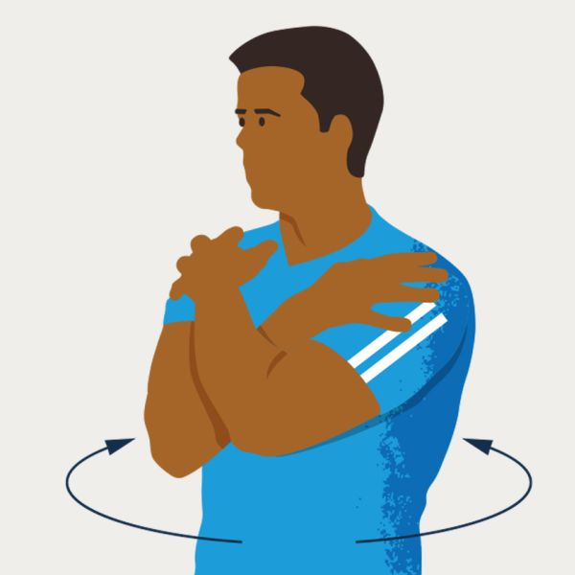
1. Seated spinal rotation
While seated, cross your arms over your chest.
Grab your shoulders.
Rotate your upper body from the waist, turning gently from left to right as far as feels comfortable.
You should feel a tension on both sides of your lower back as it stretches out.

Slide 3
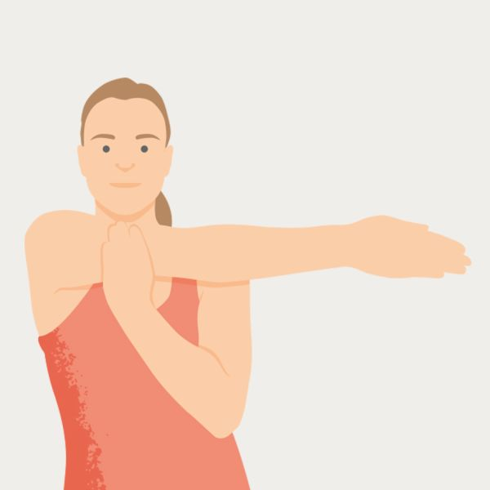
2. Posterior shoulder stretch
Hold one arm across your body.
Pull your elbow into your chest.
You should feel your shoulder gently stretching.

Slide 4
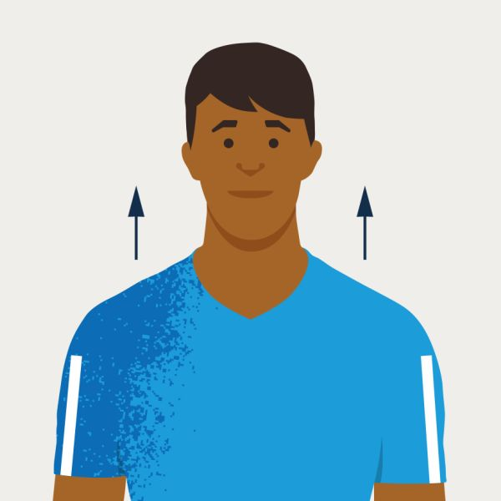
3. Shoulder shrugs
Gently lift your shoulders.
Let them slowly fall.
You should feel tension being released as your shoulders drop.

Slide 5
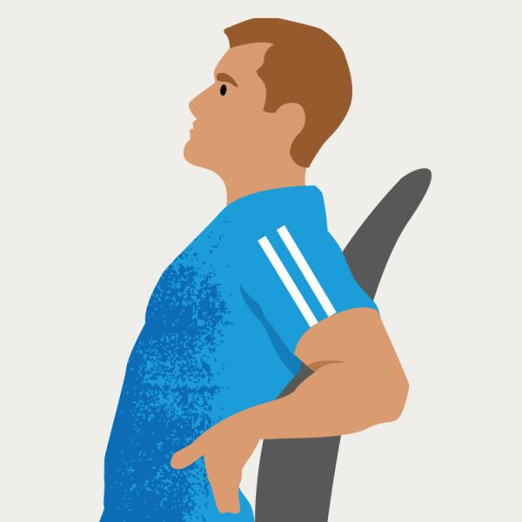
4. Sitting back extensions
Sit straight with your feet together. Put the palms of your hands into the small of your back.
Lean back over your hands, feeling your lower back stretch out.

Slide 6
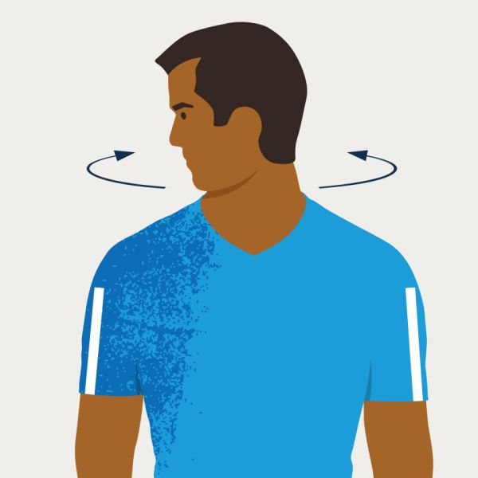
5. Neck rotations
Keep your head upright. Gently turn your head from side to side.
As you turn your head, try to move it past your shoulder.
You should feel the muscles on the outside of your neck gradually stretch.

Slide 7
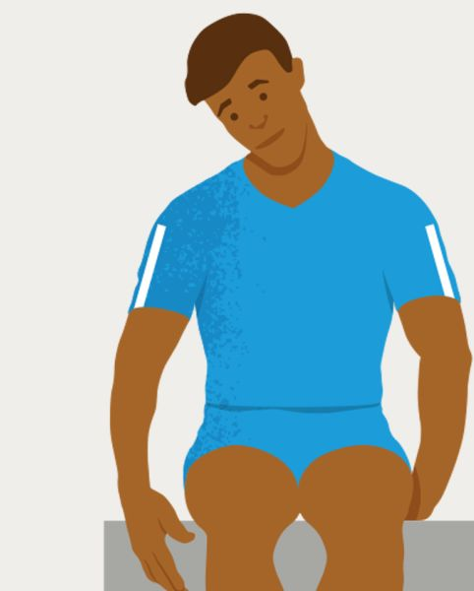
6. Upper shoulder & neck stretch
Sit on one hand.
Tilt your head away from the hand you’re sitting on.
Tilt your head slightly forward, towards your shoulder.
You should feel the muscles in your neck and shoulder being stretched.
Change sides, and repeat.

Slide 8
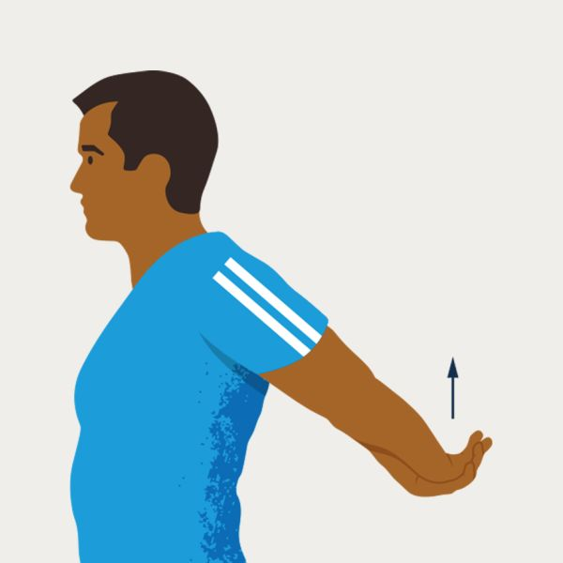
7. Shoulder extension – one
Stand up and stretch your arms out behind you.
Clasp your hands together and gently lift your arms.
You should feel your shoulders and chest stretching.

Slide 9
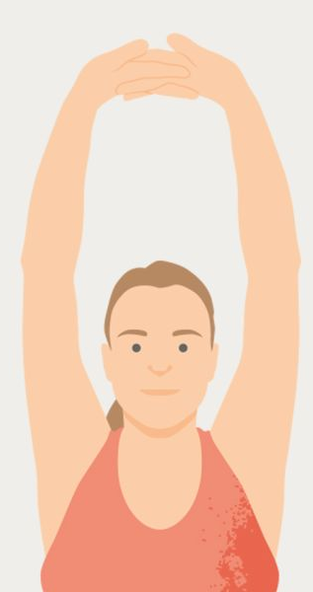
8. Shoulder extension – two
Hold both arms above your head.
Link your hands with your palms facing upwards.
Reach as high as possible.
You should feel your shoulders stretching.

Slide 10
