Slide 15
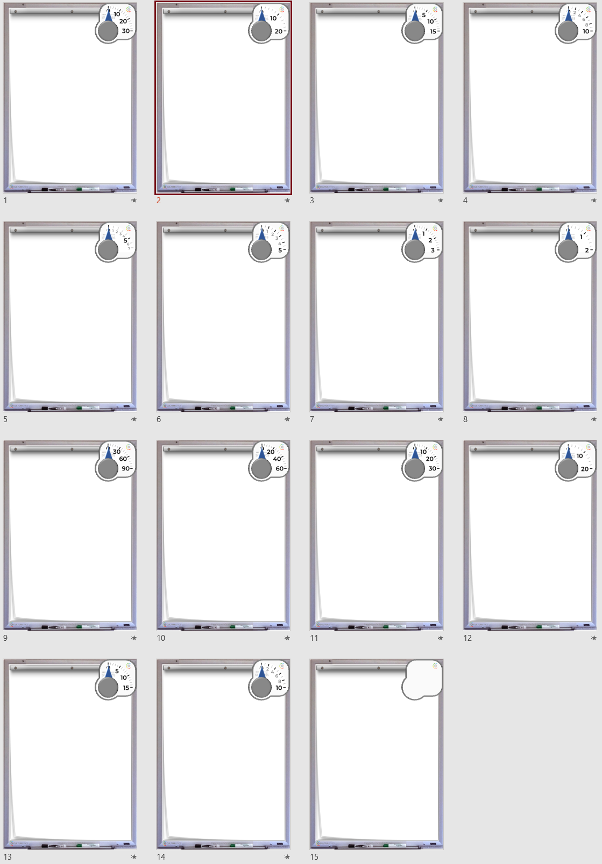
30
mins
20
mins
15
mins
10
mins
7
mins
5
mins
3
mins
2
mins
90
secs
60
secs
30
secs
20
secs
15
secs
10
secs

