Slide 14
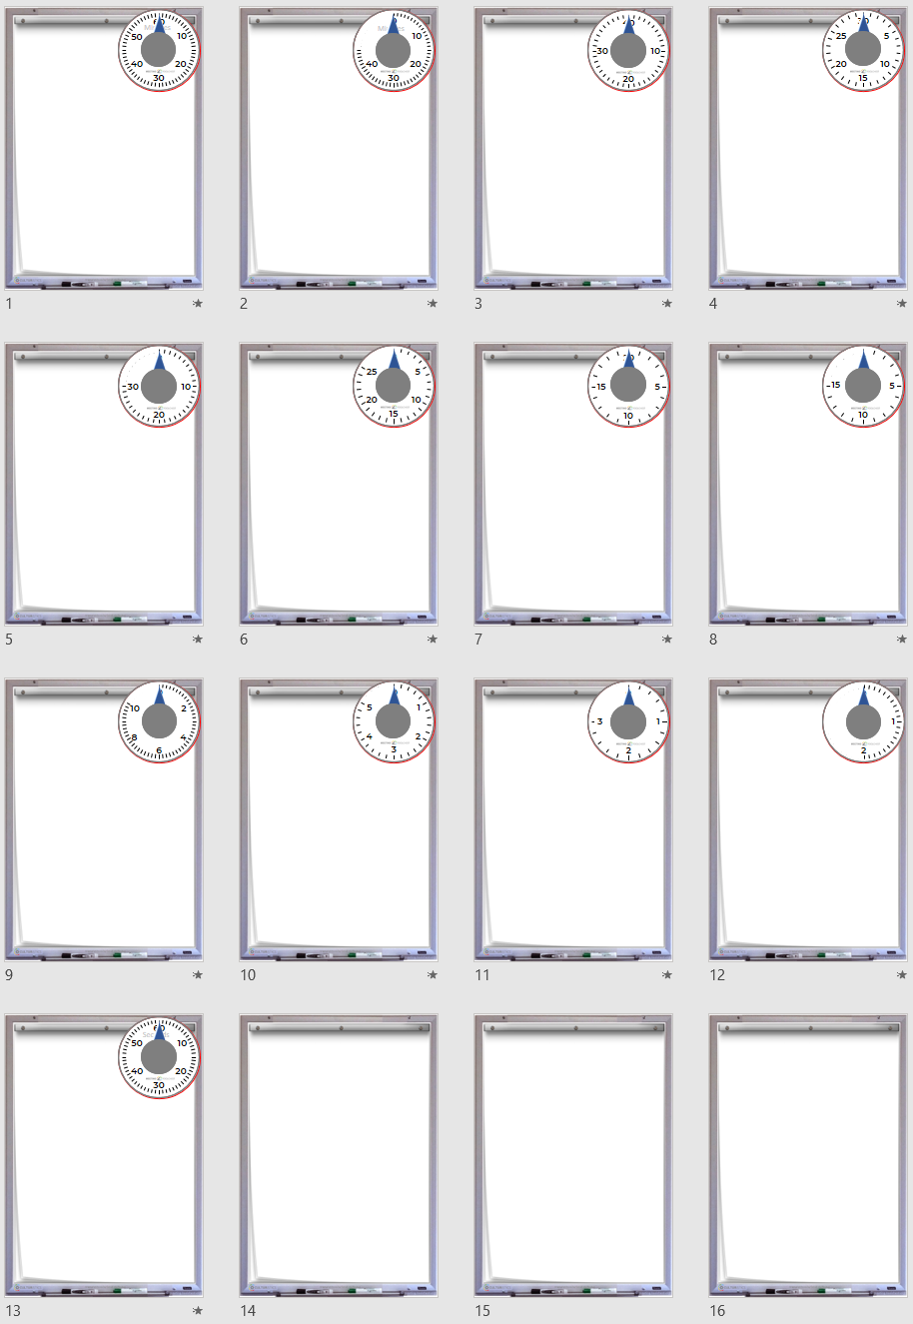
60
mins
45
mins
40
mins
30
mins
30
mins
25
mins
20
mins
15
mins
10
mins
5
mins
3
mins
2
mins
1
min

