Slide 1
Stand Up Meeting
What did I accomplish yesterday?
What will I do today?
What obstacles, if any, are impeding my progress?

Slide 2
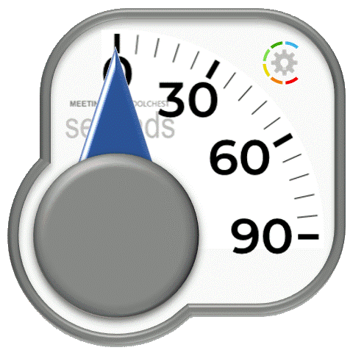
Stand Up Meeting
What did I accomplish yesterday?
What will I do today?
What obstacles, if any, are impeding my progress?

Slide 3
Notes – How this timer stand-up deck works
Slide show is set to run in Kiosk mode, which means that it cycles endlessly until you press escape
The first slide is set to automatically advance within a second, this has the effect of immediately returning to the timer slide (and resetting it)
The second slide has a big transparent rectangle over it which is hyperlinked back to the first slide. So if you click this slide in slide show it goes to slide 1, which then automatically brings you back to the timer slide and restarts it.
To use the timer, just put it into slide show mode and click it at the start of each report
If you wish to edit the timer or the words, hit escape, go to slide 2, click to select the transparent square. Send it to the back. Edit what you wish. Or replace the timer from the selection at https://meeting.toolchest.org/timers/ . Then select the transparent square, bring it back to the front, and save the result.

